Slide 1


Achieving Rawlsian fairness in food rescue
Gerdus Benade (benade@bu.edu)
With Aydin Alptekinoglu

Slide 2
Food insecurity and waste is common
USDA data on incidence of food insecurity in 2022 say:
12.8% of U.S. households
14.1% of global households
USDA estimates:
31% of all food in the US is wasted somewhere along the supply chain
92 billion lbs of food
Food rescue tries to address both issues at once
Match organizations with excess food to organizations that can distribute it where needed, in a timely manner
Notes:
ReFED (a nonprofit dedicated to fight food loss and waste)
Strengthening food rescue is among the seven key action areas they advocates for the next ten year

Slide 3
Setting: a national food rescue platform
Active in 50 states in the US
Distributed 2.9M pounds of food in 2022, and 52M pounds in 2023
Acts as a matching platform between donors and recipients
Employs FCFS (first-come-first-serve) matching – first to claim a posted donation gets it, which results in inequities in distribution
Our purpose: To improve fairness outcomes in such food rescue platforms that operate on the basis of FCFS matching
Our focus: Donations below 3,000 pounds (larger / bulk donations are handled separately)
Notes:
FL in 2023: ~20 mil pounds. Exciting time to be involved with them.

Slide 4

Food rescue operations
Act as a matching platform between donors and recipients
Each recipient sets a pickup radius, on avg. ~37km.
Notes:
Recipients are food pantries/ soup kitchens not individuals. Pickup radius, also categories interested in

Slide 5


Food rescue operations
Act as a matching platform between donors and recipients
Notes:
Different radii

Slide 6

Food rescue operations
Act as a matching platform between donors and recipients
Notes:
Donation arrives – donors: farms/ larger scale factories / bakeries / catering companies or schools with prepared food

Slide 7
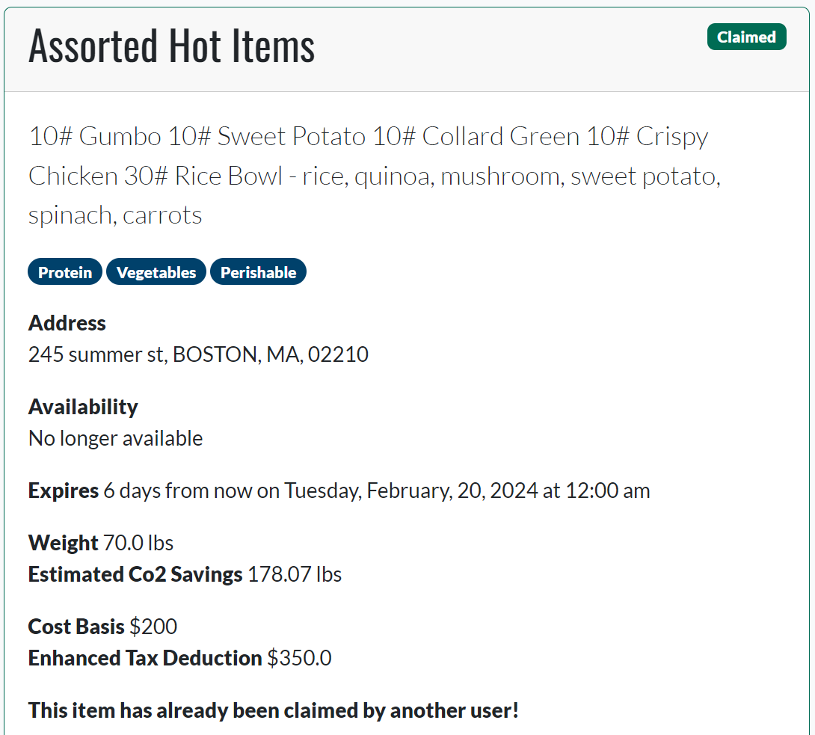
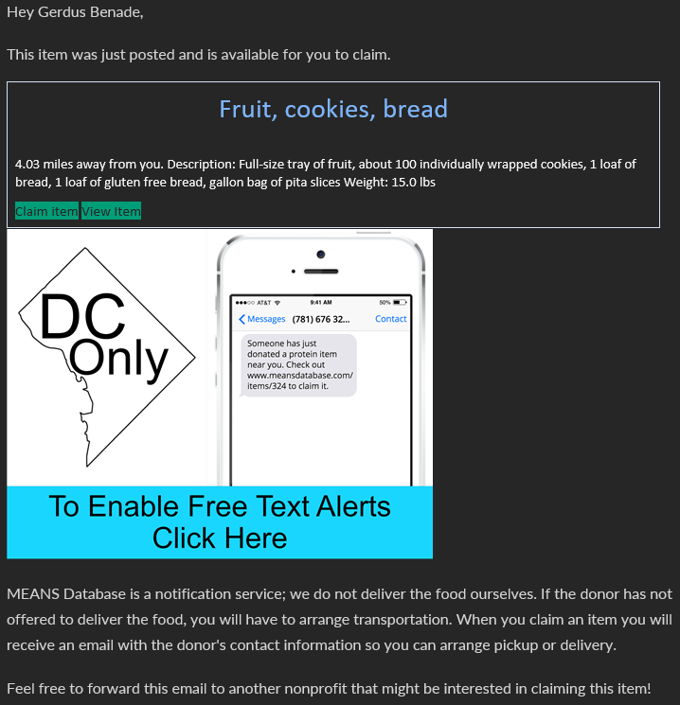
Food rescue operations
Act as a matching platform between donors and recipients
Notes:
Emphasize: recipient does transport (trying to offer delivery in a couple of states)
Deadline – expiration or shelf space

Slide 8
Food rescue operations
Act as a matching platform between donors and recipients
YES

Slide 9
Food rescue operations
Act as a matching platform between donors and recipients

Slide 10

Food rescue operations
Act as a matching platform between donors and recipients
YES
Notes:
Don’t know, and can’t elicit, agent values
We don’t get to make an allocation

Slide 11
Food rescue operations
Act as a matching platform between donors and recipients
Notes:
Don’t know, and can’t elicit, agent values
We don’t get to make an allocation

Slide 12
Food rescue operations
A matching platform between donors and recipients
Employs FCFS (first-come-first-serve) matching – first to claim a posted donation gets it, which results in inequities in distribution
Historically
Vast majority of donations are successfully claimed
Average claim time ~5.5 hours, avg. deadline 210 hours
~90% of matched items travel less than 50km
Notes:
Bulk donations separate, drivers experiments in some cities, agreements with recurring donors

Slide 13
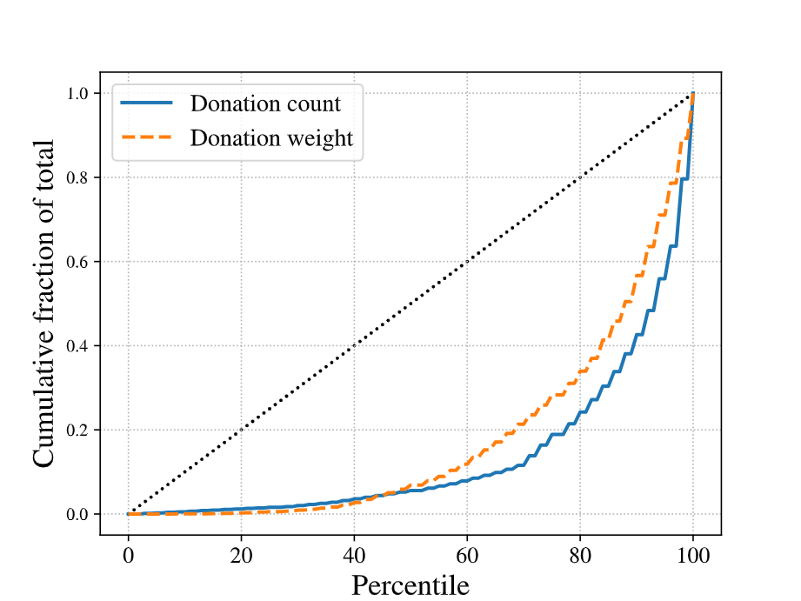
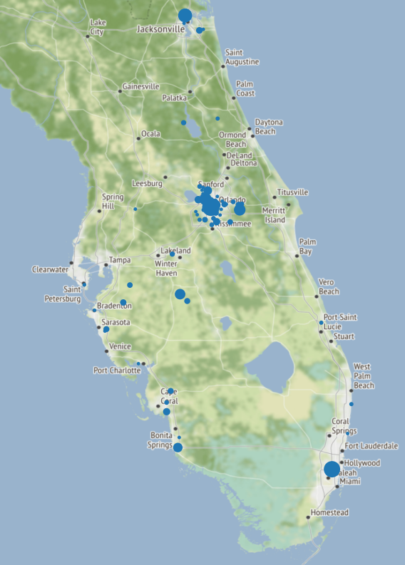
Outcomes: May 2021 – Sept 2023
Bottom 60% of recipients get 13% of weight
Bottom 60% of recipients get 8% of items
Notes:
These plots only consider those recipients that have received something since 2018
~70% of recipients signed up in FL have never received anything
Similar size organizations, all vying for relatively small donations <3000lbs, no bulk donations
Minimal changes from current system
- claiming system – cant allocate
- no value elicitation

Slide 14
Key idea to improve fairness Prioritize select recipients by giving them a headstart

Slide 15



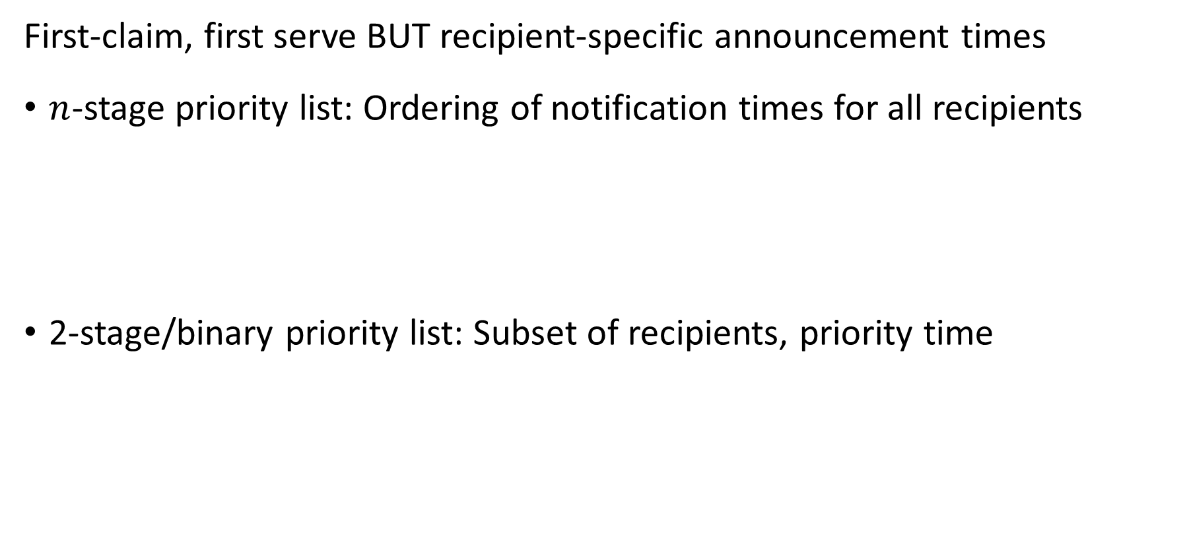
Priority lists
First-claim, first serve BUT recipient-specific announcement times
$n$-stage priority list: Ordering of notification times for all recipients
2-stage/binary priority list: Subset of recipients, priority time
0
1hr
3hrs
2 days
0
2hrs
2 days
Notes:
You could imagine other things, artificial currency, wait for two to respond give to worst-off etc
Added benefit – existed in some form eg church of some denomination prefers donation goes to food pantry of same denomination

Slide 16
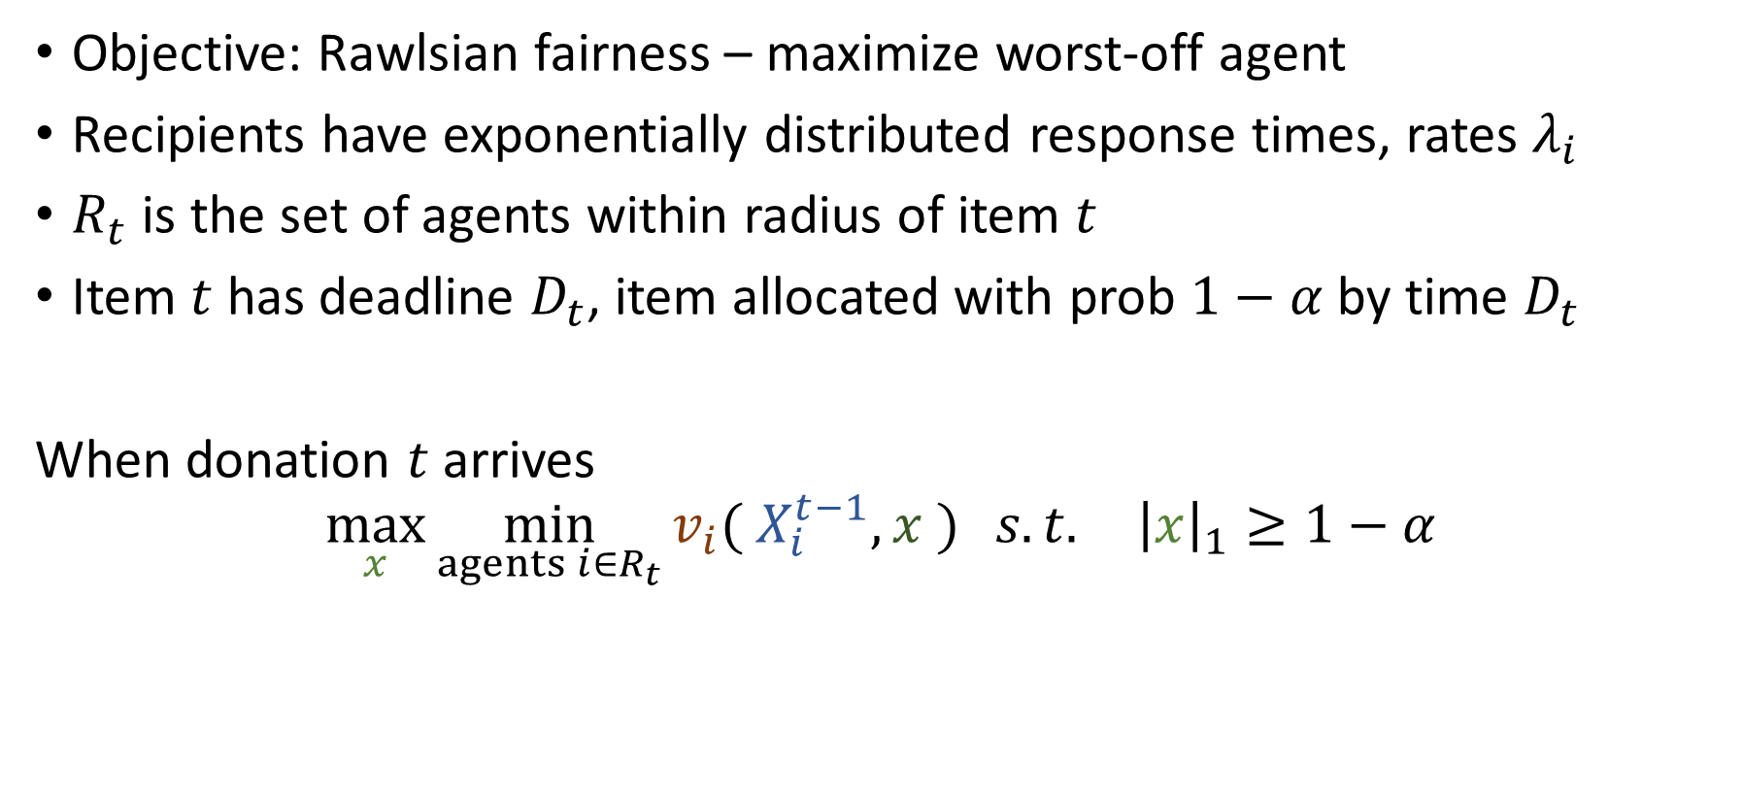
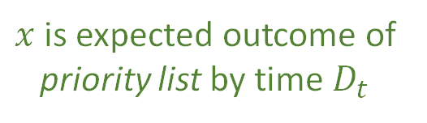
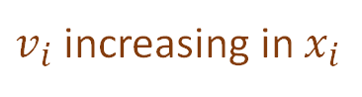


Model
Objective: Rawlsian fairness – maximize worst-off agent
Recipients have exponentially distributed response times, rates $λ_{i}$
$R_{t}$ is the set of agents within radius of item $t$
Item $t$ has deadline $D_{t}$, item allocated with prob $1−α$ by time $D_{t}$
When donation $t$ arrives
$$\max_{x}{\min_{agents i∈R_{t}}{v_{i}( X_{i}^{t−1}, x )} s.t. {\left|x\right|}_{1}≥1−α}$$
Existing allocation of prior items to $i$
Wastage constraint
Expected allocation of item $t$
$v_{i}$ increasing in $x_{i}$
$x$ is expected outcome of priority list by time $D_{t}$
Number of items
Pounds of items
Frac. of agent’s demand
Notes:
Objective – max unique recipients. Little demand information, couple of surveys, contacts etc, still enough uncertainty about what makes a reasonable objective.

Slide 17
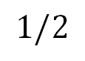
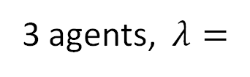

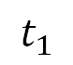

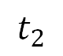
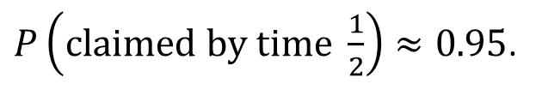

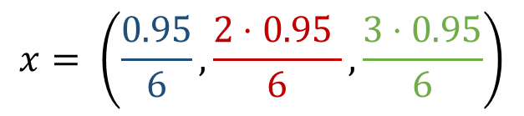
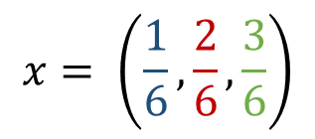
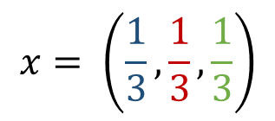
Example
1
2
3
3 agents, $λ=$
No deadline, no priority list
$$x= \left(\frac{1}{6},\frac{2}{6},\frac{3}{6}\right)$$
0
$$∞$$
No deadline, n-stage priority list
$$x= \left(\frac{1}{3},\frac{1}{3},\frac{1}{3}\right)$$
0
$$∞$$
$$t_{1}$$
$$t_{2}$$
Deadline of ½, $α=0.05,$ n-stage priority list
$P\left(claimed by time \frac{1}{2}\right)≈0.95$.
$$x= \left(\frac{0.95}{6},\frac{2⋅0.95 }{6},\frac{3⋅0.95}{6}\right)$$
0
$$1/2$$
Notes:
n-stage can achieve any fraction without deadline, 2 stage obviously cant

Slide 18
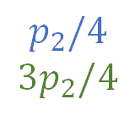
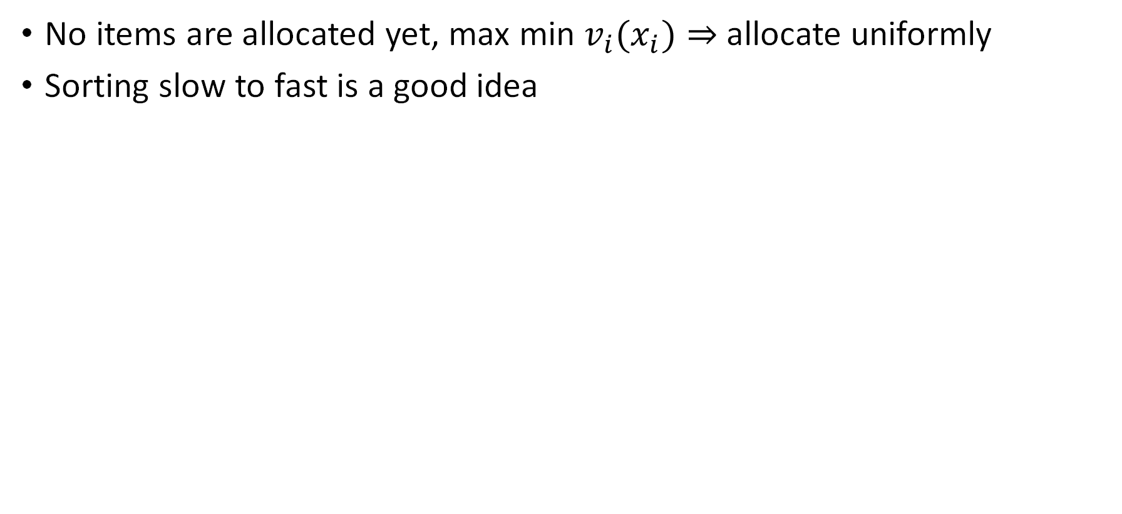

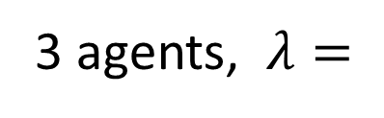
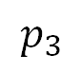
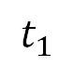
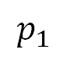
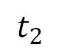
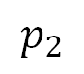
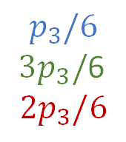
Allocating the first item
No items are allocated yet, max min ${v_{i}(x}_{i})⇒$ allocate uniformly
Sorting slow to fast is a good idea
3 agents, $λ=$
1
2
3
$$p_{1}$$
$$p_{2}$$
$$p_{3}$$
0
$$t_{1}$$
$$t_{2}$$
$$p_{1}$$
$$p_{2}/4$$
$$3p_{2}/4$$
$$p_{3}/6$$
$3p_{3}/$6
$$2p_{3}/6$$
doesn’t need a head-start over
3
2
Notes:
Suppose we don’t sort slow to fast

Slide 19
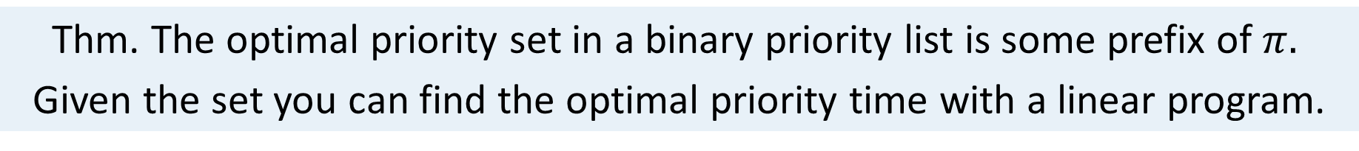
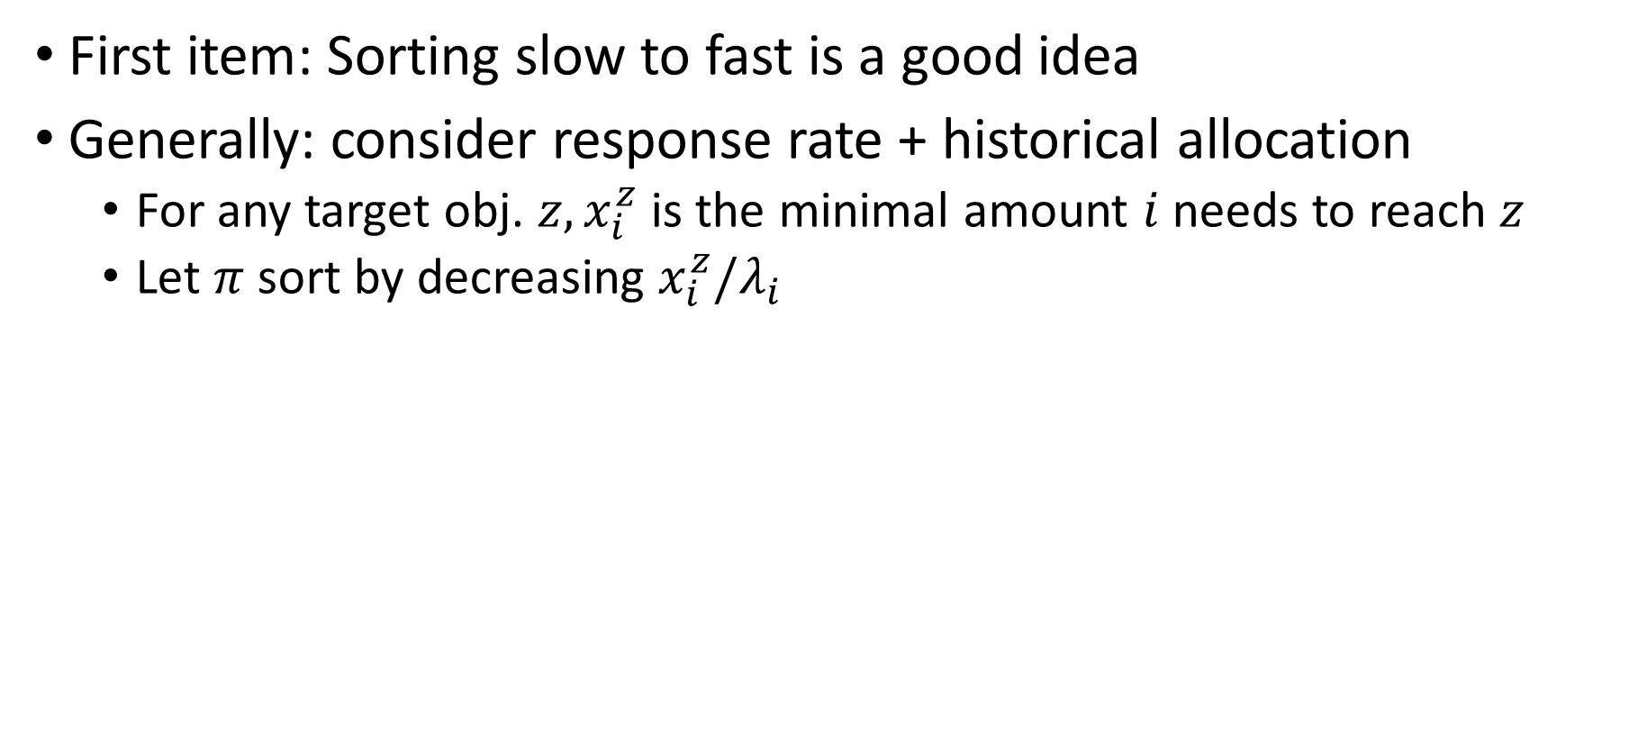

Designing optimal priority lists
First item: Sorting slow to fast is a good idea
Generally: consider response rate + historical allocation
For any target obj. ${z, x}_{i}^{z}$ is the minimal amount $i$ needs to reach $z$
Let $π$ sort by decreasing $x_{i}^{z}/λ_{i}$
Thm. For any objective value $z,$ if $z$ is achievable with an $n$-stage priority list, then prioritizing by $x_{i}^{z}/λ_{i}$ works
Thm. The optimal priority set in a binary priority list is some prefix of $π.$
Given the set you can find the optimal priority time with a linear program.

Slide 20
Quantifying the practical impact of priority lists

Slide 21
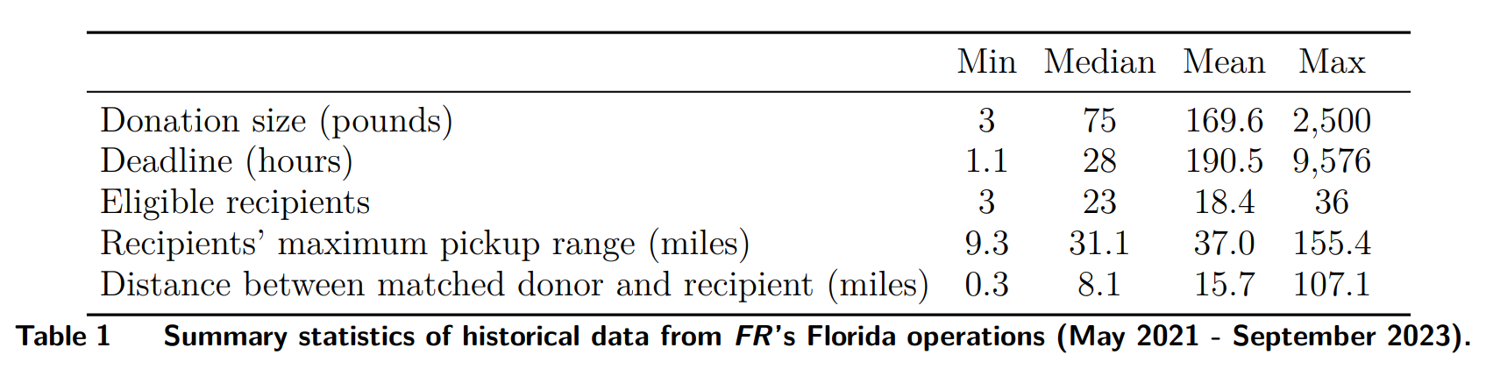
Simulations calibrated by operations in Florida
Allocation data 2021-2023
Estimate response rates
Draw donors, donation sizes, deadlines from historical distributions
Two valuation functions: Number of items, total pounds
Notes:
65% claimed by 1 hour; 60% items available for 1 day

Slide 22
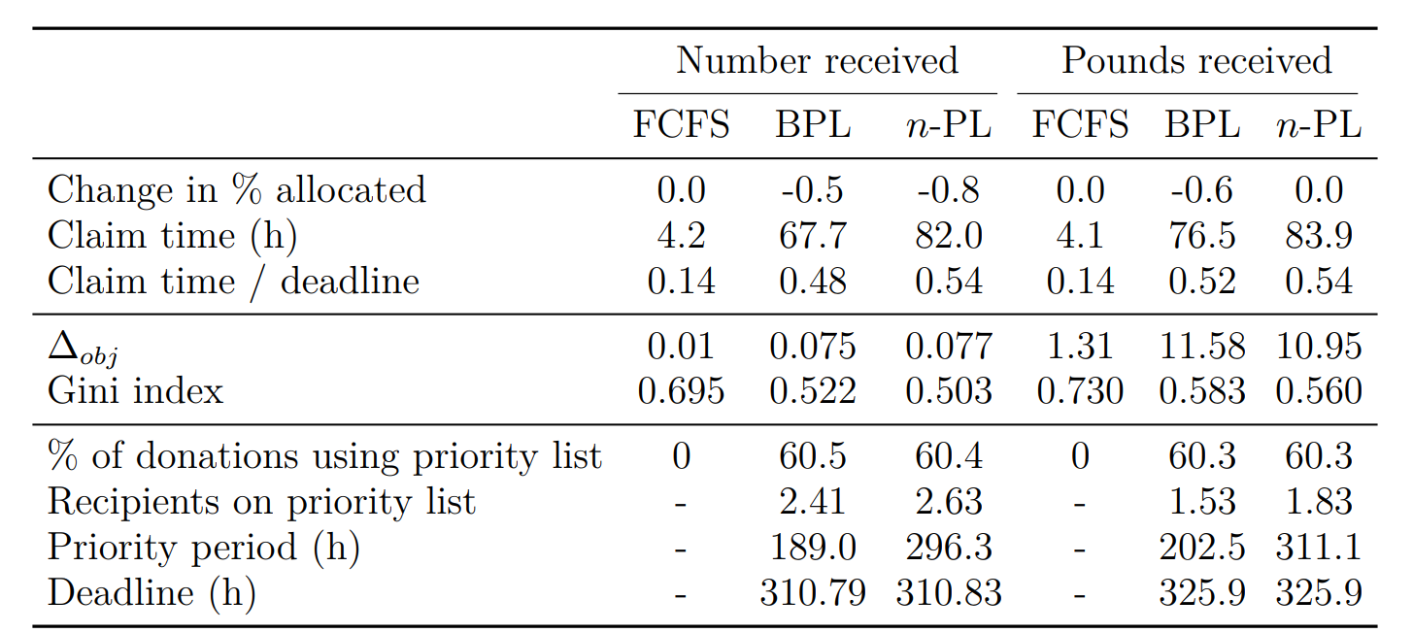
Notes:
No increase in waste

Slide 23
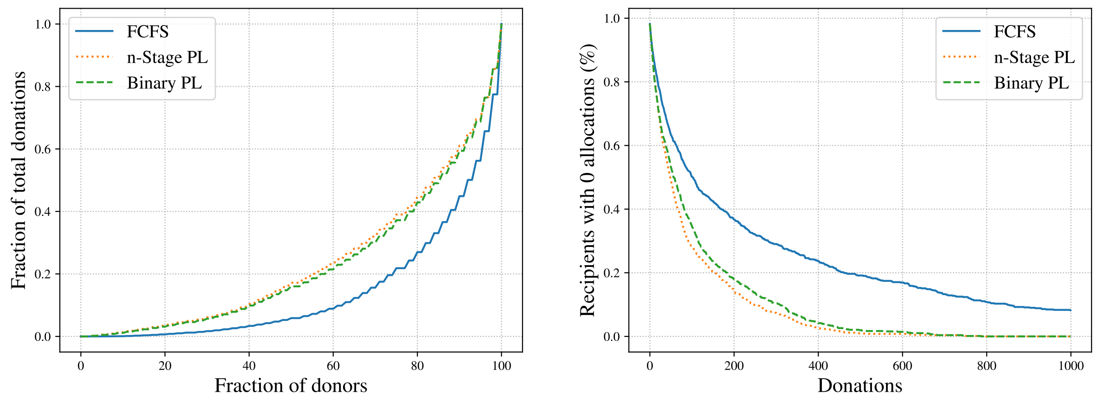
Notes:
No increase in waste

Slide 24
Notes:
No increase in waste

Slide 25
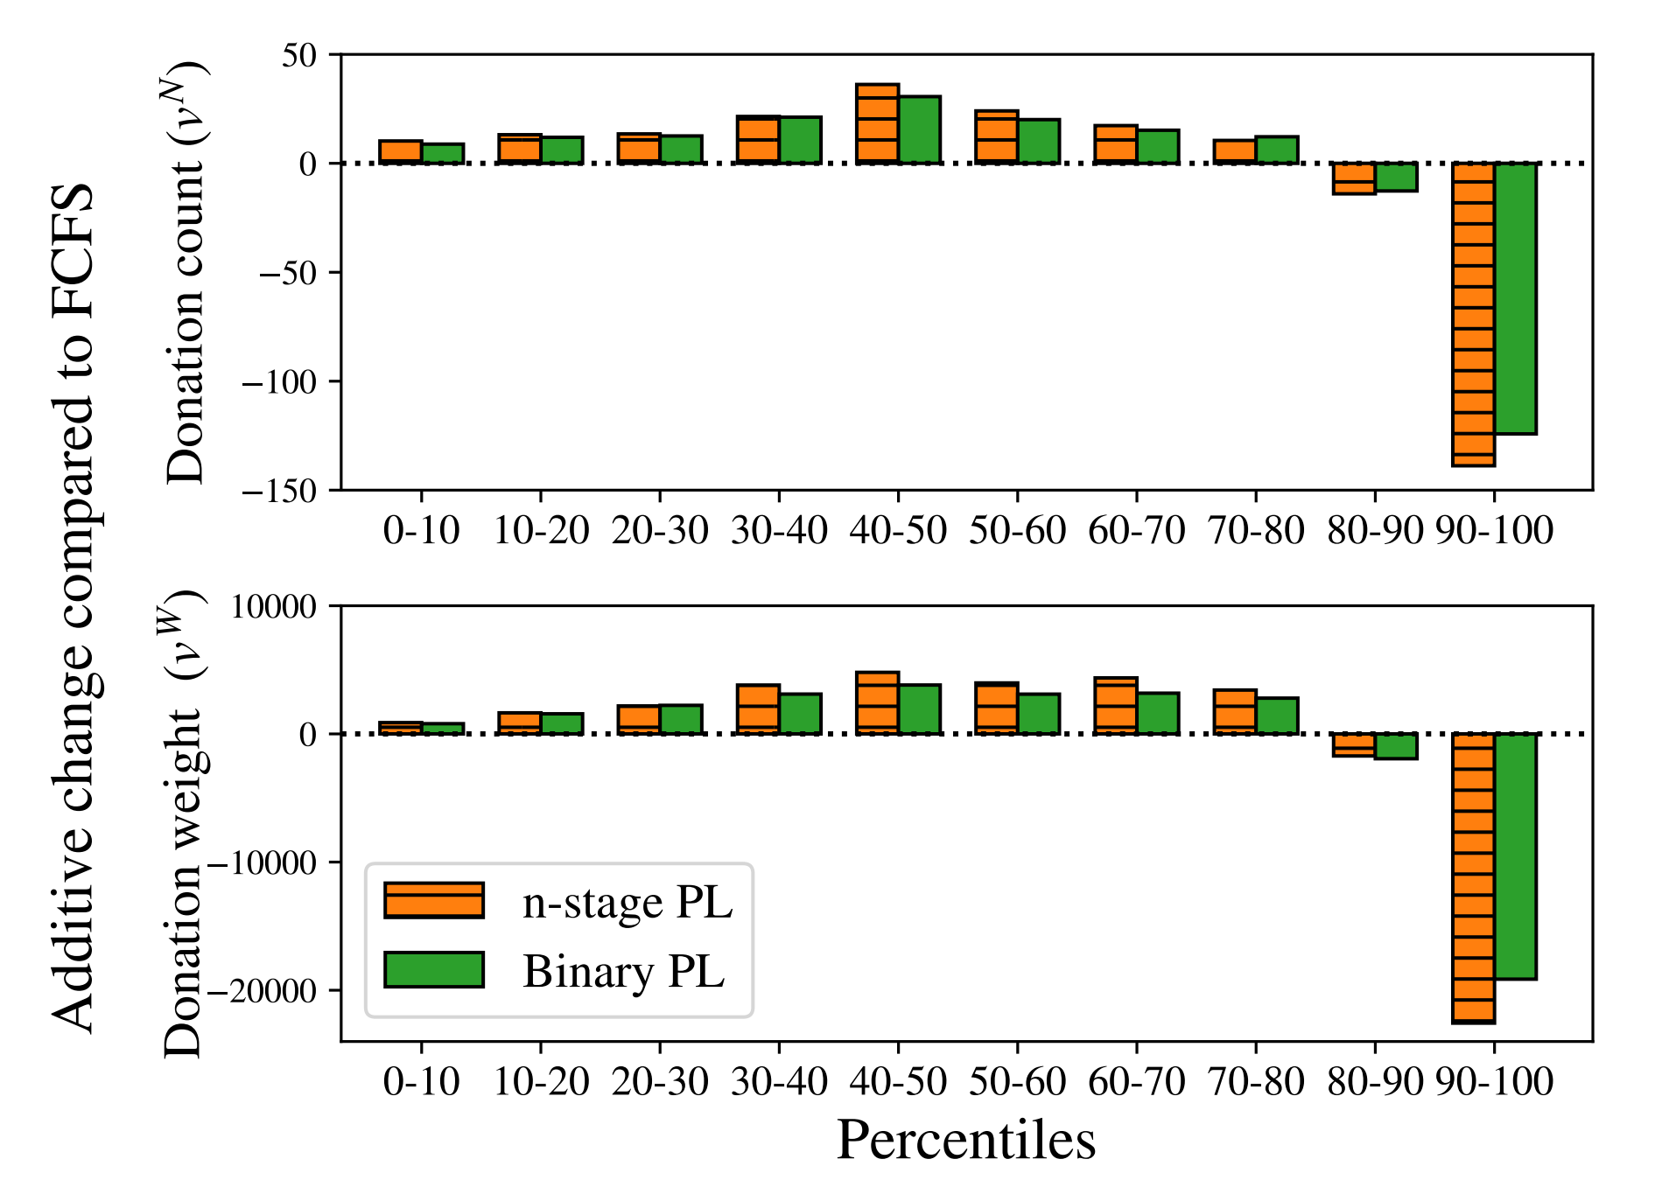
Redistribution
*Additive change
by decile

Slide 26
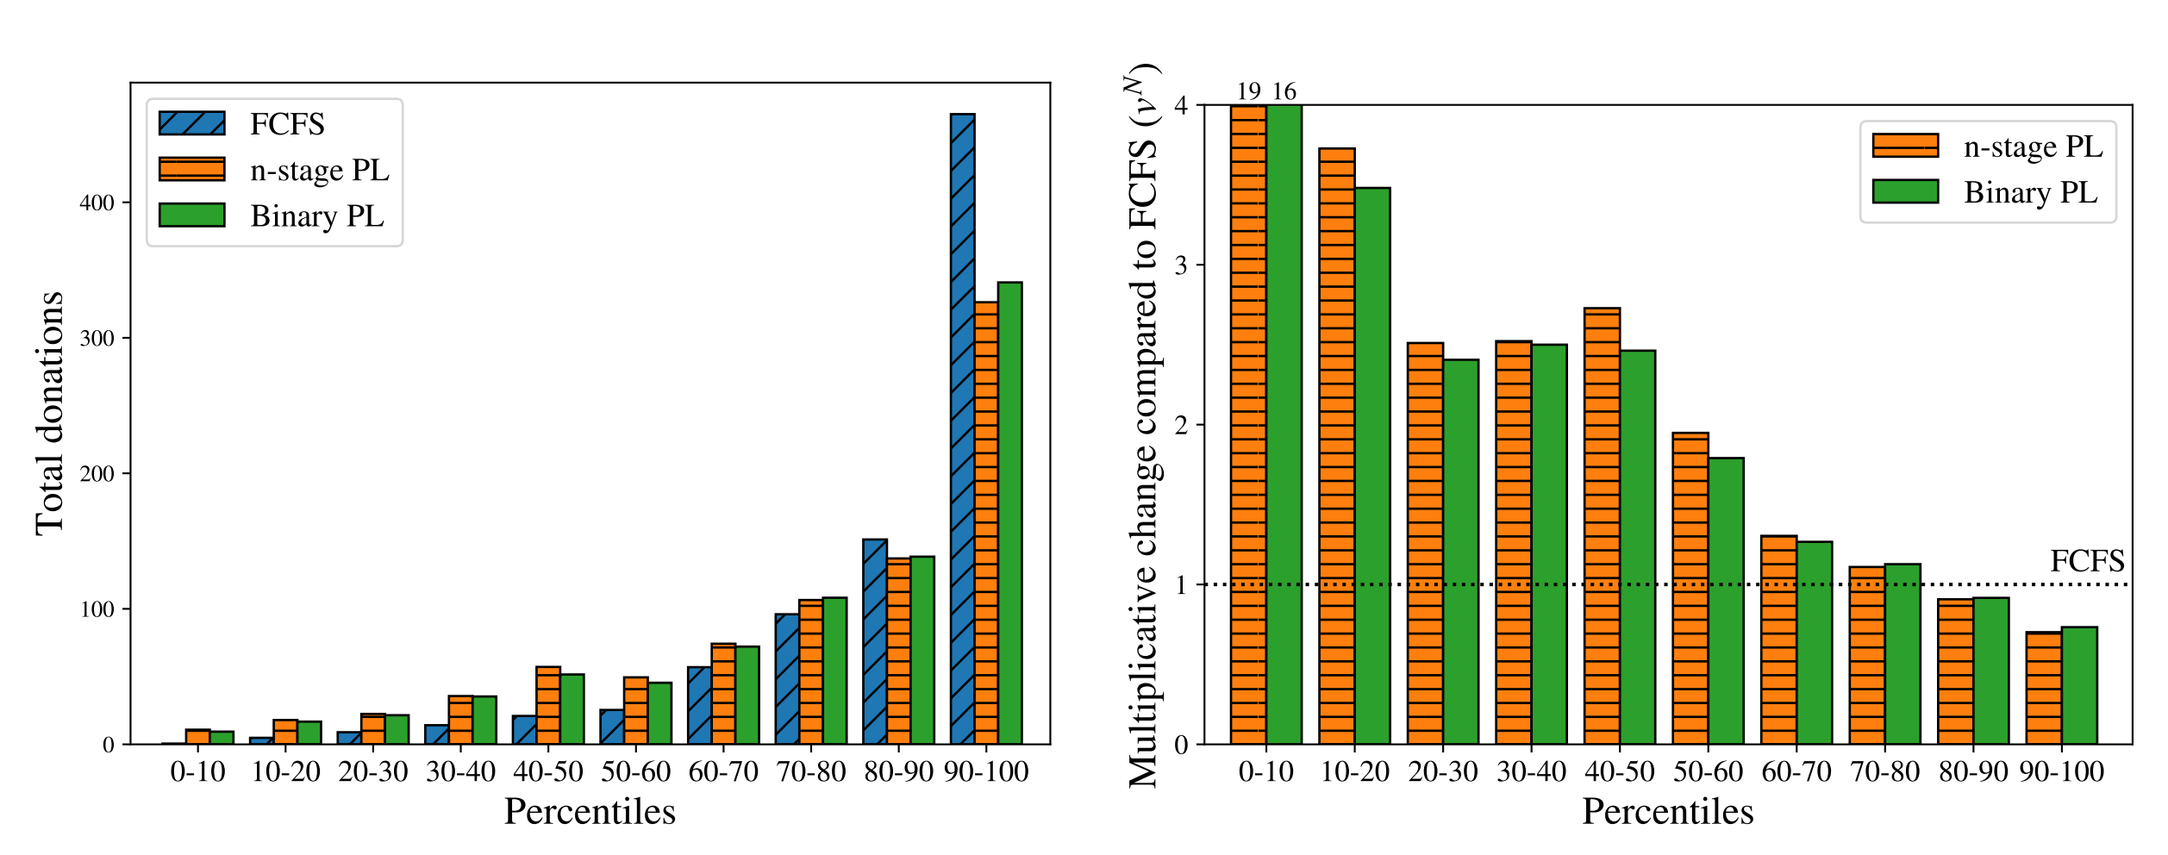
Redistribution
*Mult. change
by decile

Slide 27
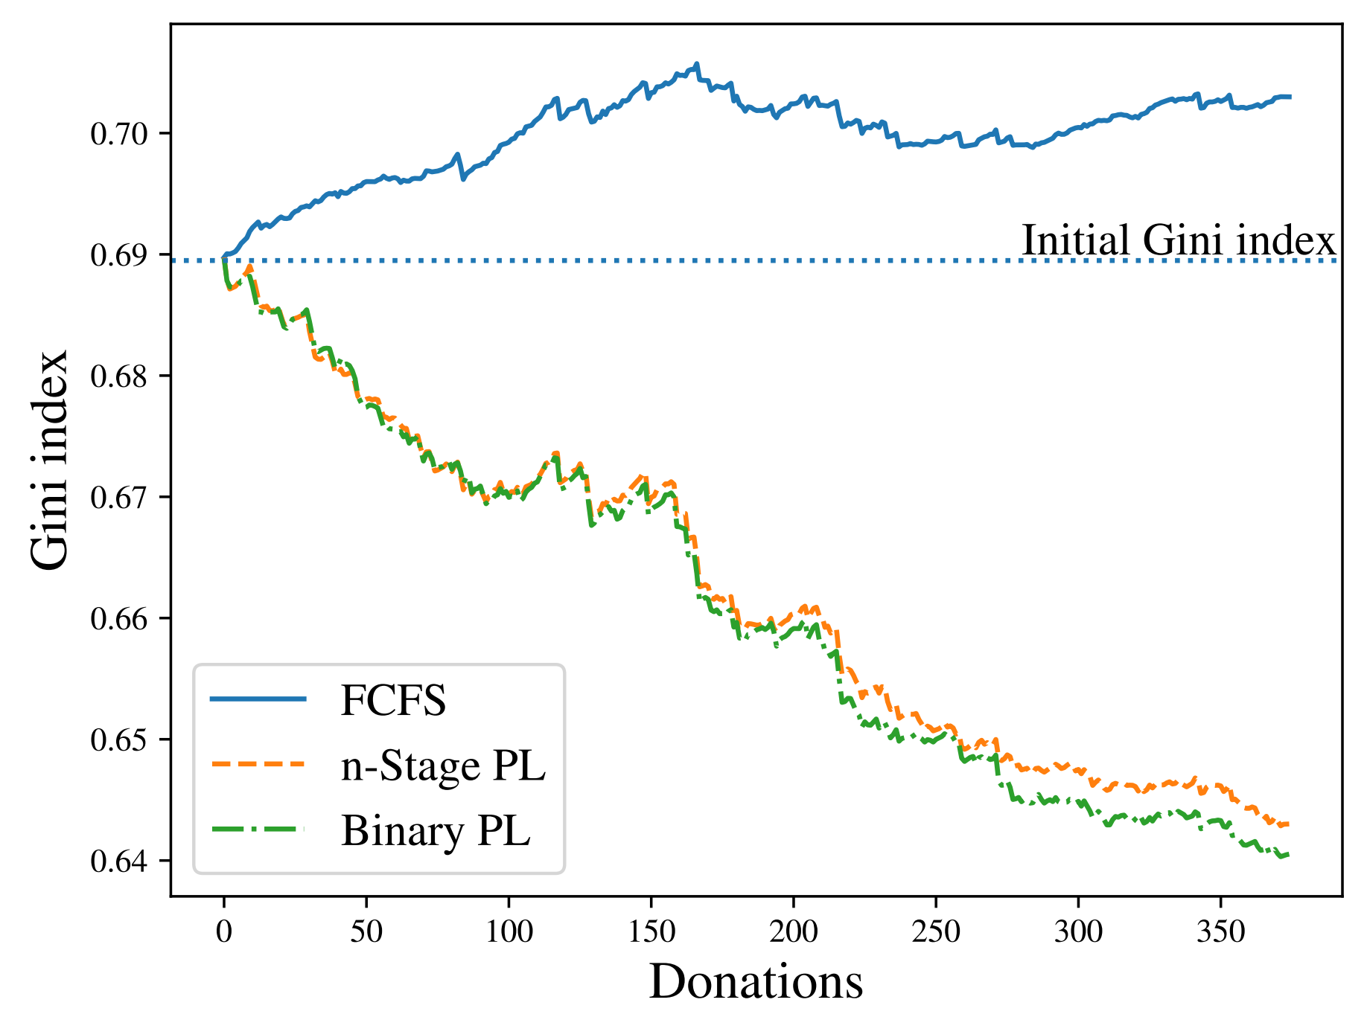
Starting from an inequitable historical state

Slide 28

Discussion
Implementation in progress
Gap between theory and practice
Very few organizations elicit agent values (notable exception: Feeding America)
The matching algorithm does not usually get to decide the allocation
Future work
Logistical constraints: transportation, storage space, current demand, etc.
Notes:
Deciding the allocation: with agents arriving model request as stochastic, items arriving

Slide 29
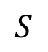
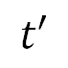
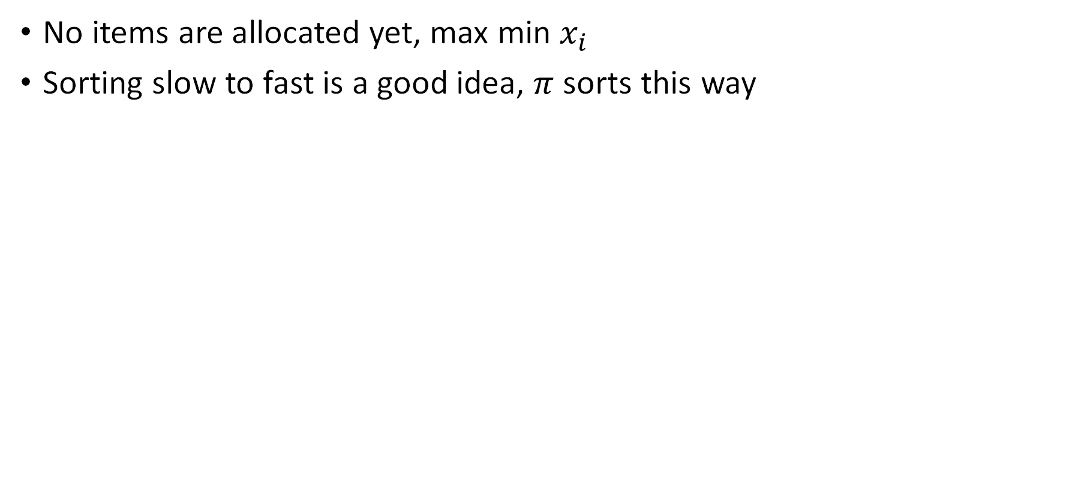
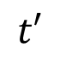
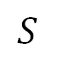
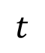
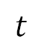
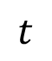
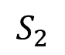
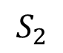
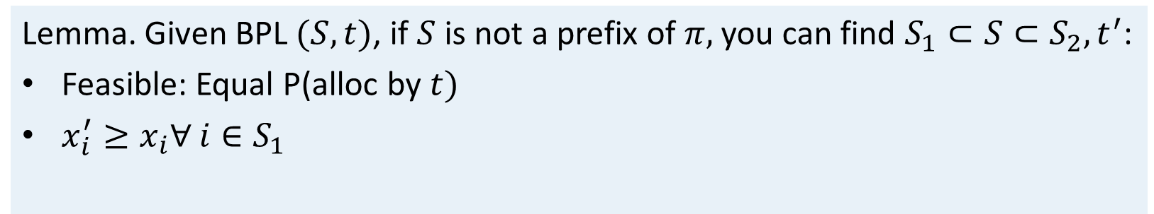
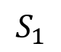
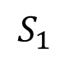
Binary priority lists: Allocating the first item
No items are allocated yet, max min $x_{i}$
Sorting slow to fast is a good idea, $π$ sorts this way
Lemma. Given BPL $(S, t)$, if $S$ is not a prefix of $π,$ you can find $S_{1}⊂S⊂S_{2}, t^{′}$:
Feasible: Equal P(alloc by $t)$
$x_{i}^{′}≥x_{i}∀$ $i∈S_{1}$
$$S$$
$$t$$
$$S_{1}$$
$$t′$$
$$S_{2}$$
$$t$$
$$S$$
1
2
4
$$t$$
1
2
3
4
1
2
$$t′$$
1
2
3
4
$$t$$
1
2
3
4
$$S_{1}$$
$$S_{2}$$
Notes:
If original satisfies allocation constraint, we still do
Objective weakly increases

Slide 30
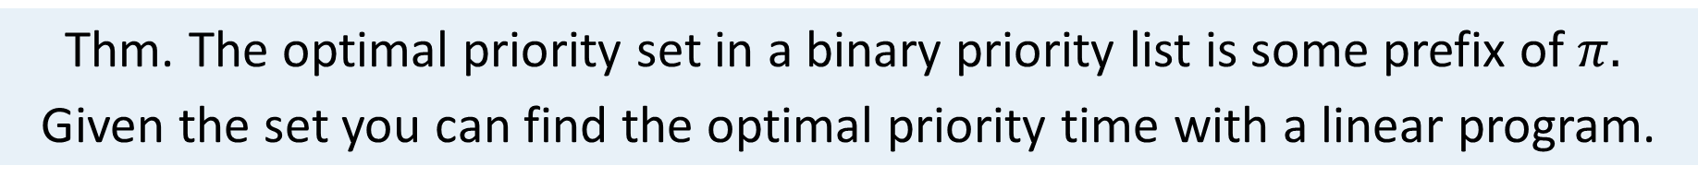
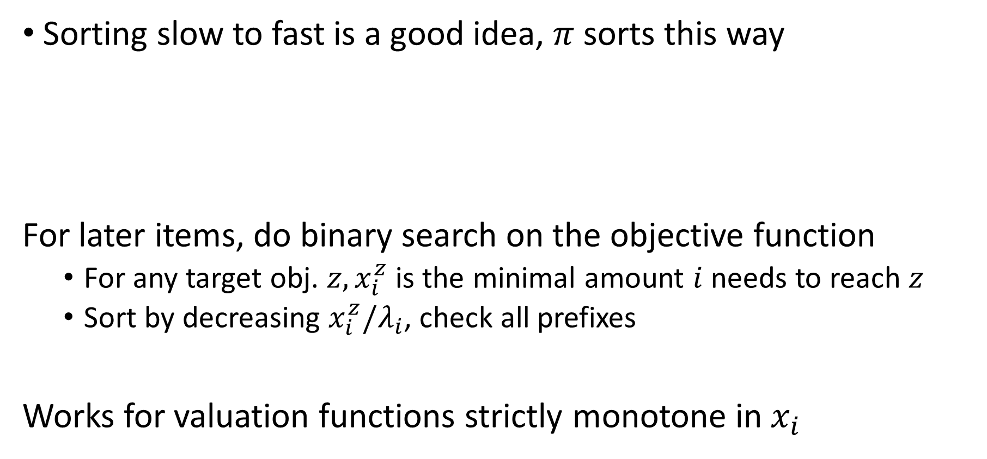
Binary priority lists
Sorting slow to fast is a good idea, $π$ sorts this way
For later items, do binary search on the objective function
For any target obj. ${z, x}_{i}^{z}$ is the minimal amount $i$ needs to reach $z$
Sort by decreasing $x_{i}^{z}/λ_{i}$, check all prefixes
Works for valuation functions strictly monotone in $x_{i}$
Thm. The optimal priority set in a binary priority list is some prefix of $π.$
Given the set you can find the optimal priority time with a linear program.

Slide 31
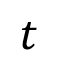
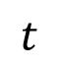







$n$-stage priority lists
Thm. For any objective value $z,$ if $z$ is achievable then prioritizing by $x_{i}^{z}/λ_{i}$ works
Lemma 1 (Decomposition). Given BPL $(S, t)$, if $S$ is not a prefix of $π,$ you can find $S_{1}⊂S⊂S_{2}, t^{′}$:
Feasible: Equal P(alloc by $t)$
$x_{i}^{′}≥x_{i}∀$ $i∈S_{1}$
$$S$$
$$t$$
$$S_{1}$$
$$t′$$
$$S_{2}$$
$$t$$
Lemma 2 (Sorting). Consider consecutive periods $\left(H, t_{H}\right), \left(L, t_{L}\right).$If $λ\left(H\right)>λ\left(L\right),$then there exists $t_{H}^{′}, t_{L}^{′}$ so that $t_{H}^{′}+t_{L}^{′}≤t_{H}+t_{L}$ and all allocation probabilities remain the same in the schedule$\left(L, t_{L}^{′}\right),\left(H, t_{H}^{′}\right)$

Slide 32




$n$-stage priority lists
Given order, you can find optimal announcement times
Binary search over $z$
Thm. For any objective value $z,$ if $z$ is achievable then prioritizing by $x_{i}^{z}/λ_{i}$ works
Initial PL
3
13
134
1234
Repeated
decomp.
$$∅$$
13
1
123
1
1234
1234
Lemma 1 +
memoryless
$$∅$$
1
123
1
123
1
1234
1234
$$D_{t}$$
Final PL
$$∅$$
1
1
1
123
123
1234
1234
Sorting lemma

